Slide 1
Sub Comander
Accessible Game - SS12: Project Possibility
Evan Greenstone, Patrick Fay, Anoop Kamboj, Alex Silkin

Slide 2
The Task
Create an interactive experience on the desktop to be played by individuals with visual impairments
Our Goal
Create a game that only relies on the auditory senses

Slide 3


Brainstorming

Slide 4
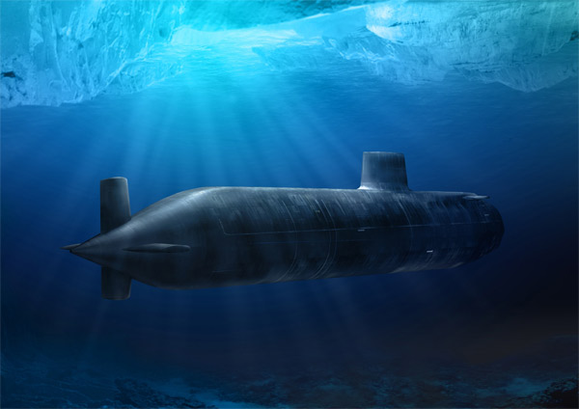
Final Design
Feels natural to play a submarine game using sound
Crew’s feedback aids immersion

Slide 5
Gameplay
Sonar

Slide 6
